Slide 1
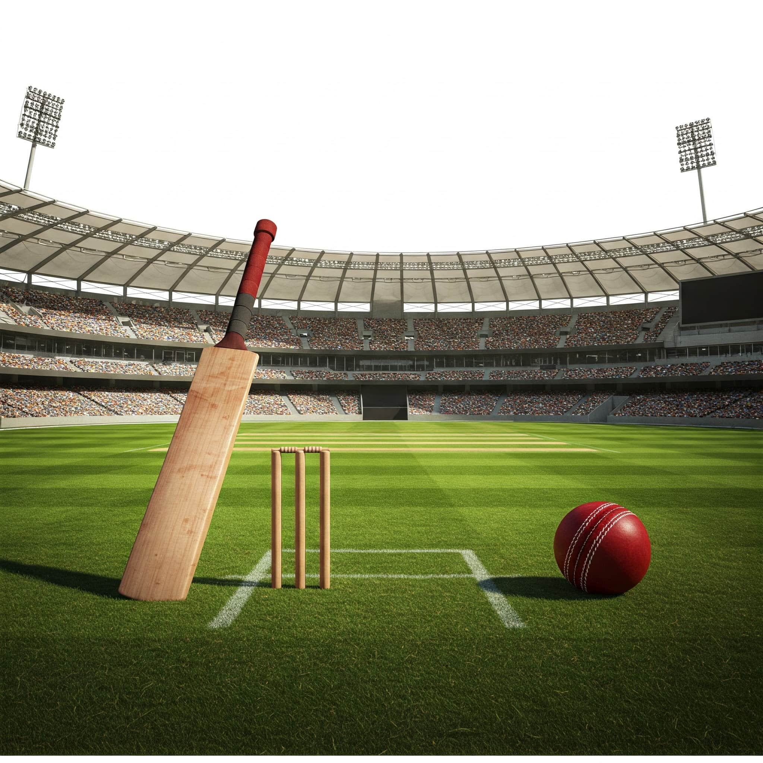
IPL 2024 ANALYSIS
A RESEARCH PROJECT BY SHRABANI GHOSH

Slide 2

TABLE ANALYSIS
TABLE 1 : AUCTION
TABLE 2 : BATSMAN
TABLE 3 : BOWLER
Auction contains Player ID,Player Name, Acquisition, Team, Price, Type, Role
Batsman contains Player Name, Team, Runs, Match, Innings, No Ball, Highest Score, Average, Ball Faced, Strike Rate, 100, 50, 4S, 6S
Bowler contains Player Name, Team, Wickets, Match, Innings, Over, Runs, Average, Economic Rate, Strike Rate, 4W, 5W
Add a

Slide 3
OBJECTIVES
To explore role and acquisition wise trends in pricing and team distribution.
To evaluate the cost-effectiveness of players based on auction prices and performance.

Slide 4
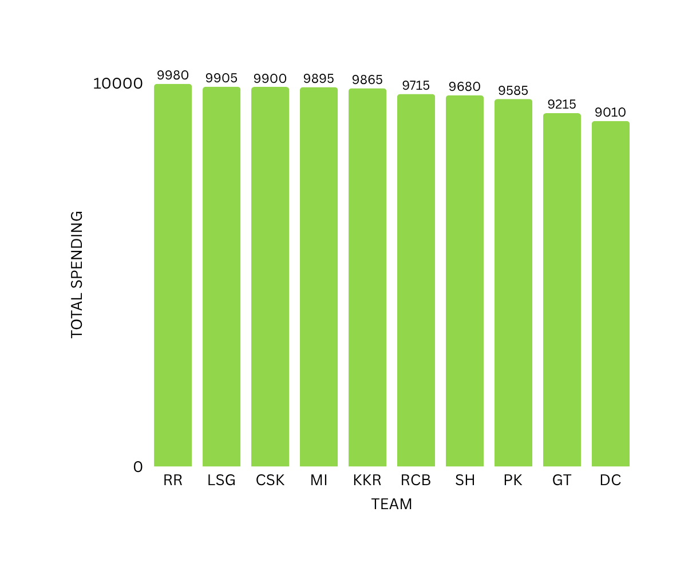
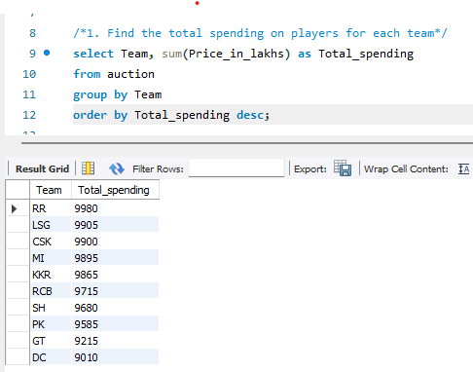
TEAM-WISE TOTAL SPENDING

Slide 5
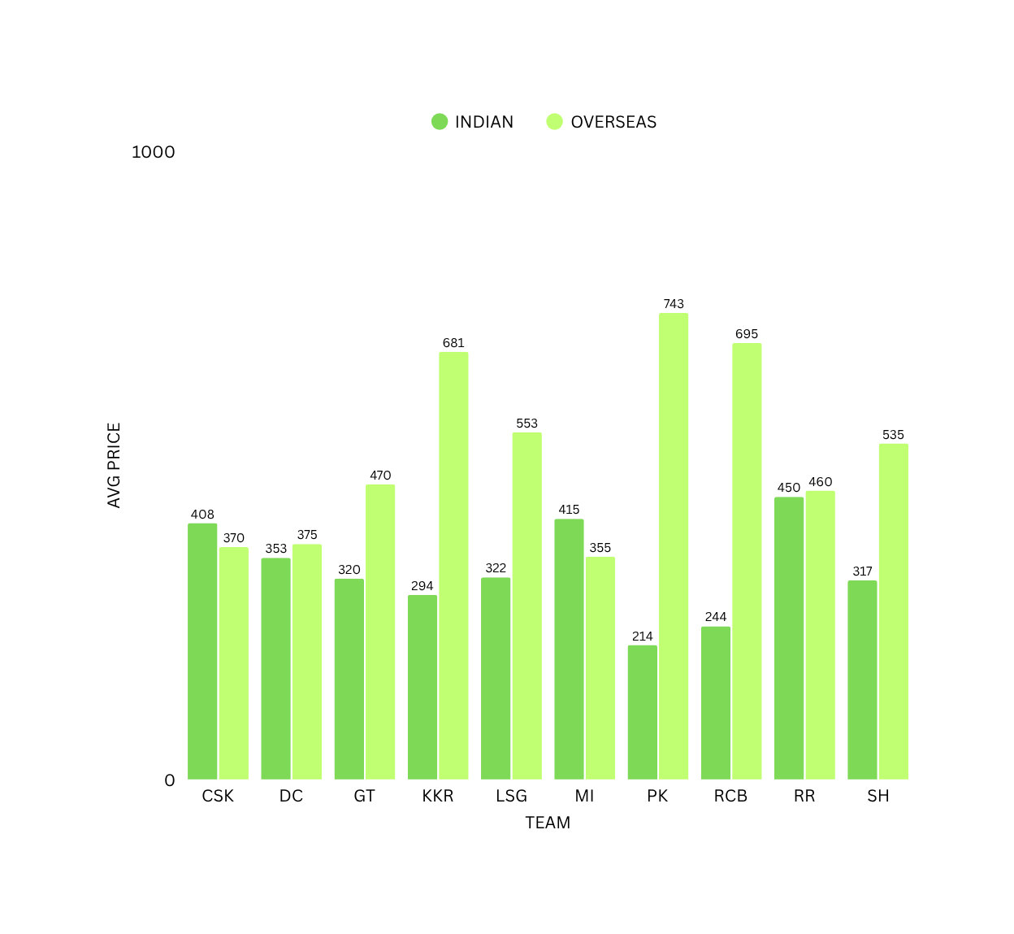
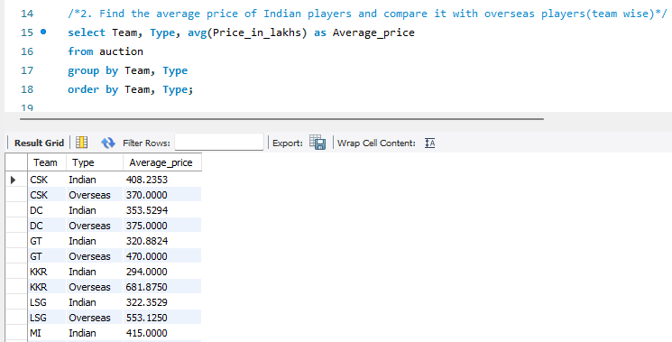

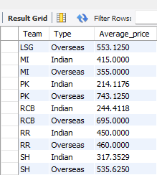
COMPARISON OF AVG PRICES ACCORDING TO TYPE & TEAM

Slide 6
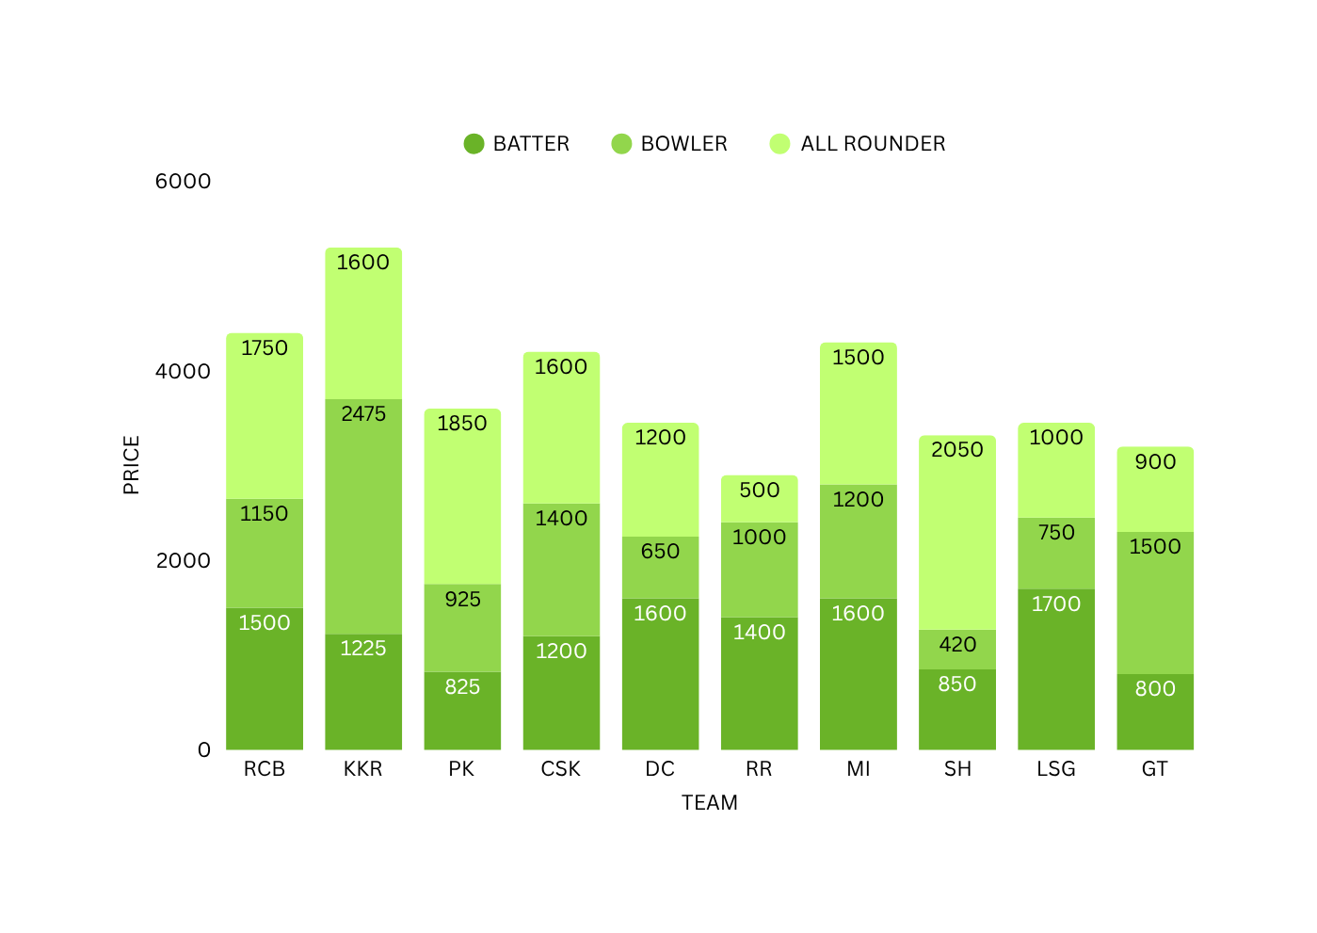
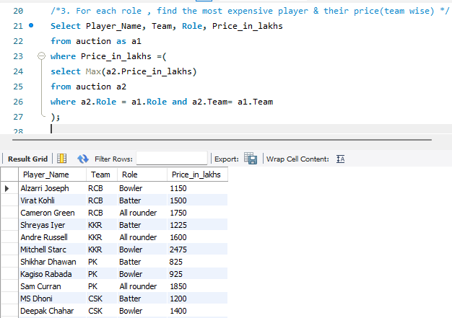
COMPARISON OF PRICE ACCORDING TO ROLE FOR EACH TEAM

Slide 7
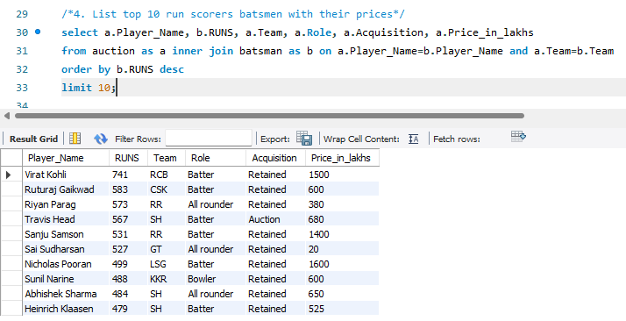
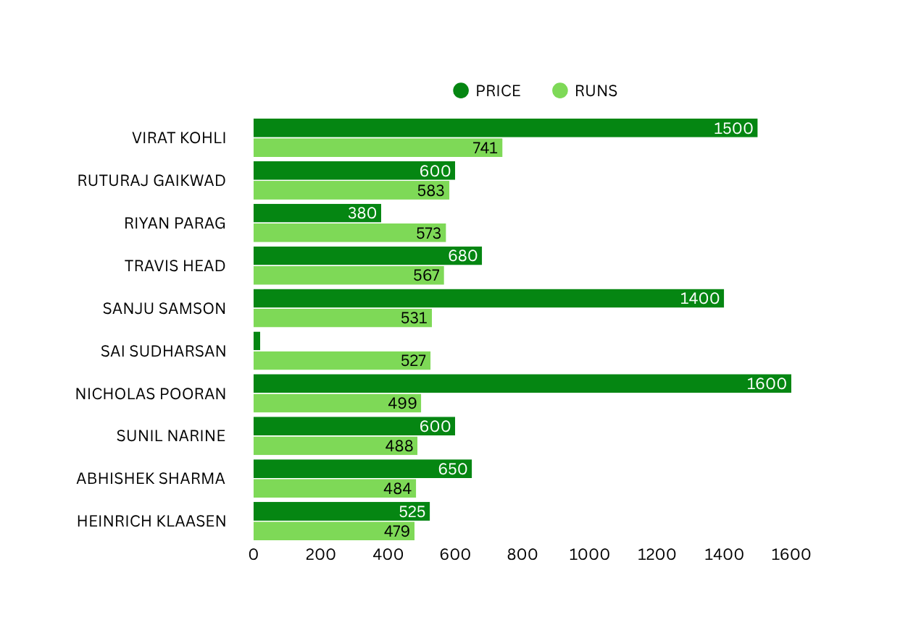

PRICE VS PERFORMANCE OF TOP 10 BATSMAN

Slide 8
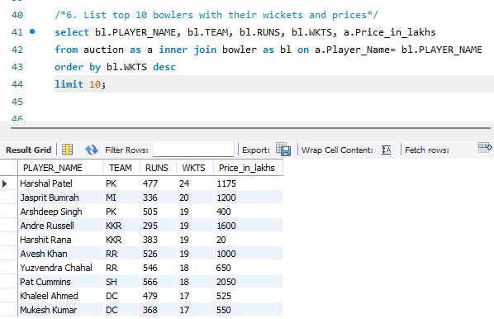
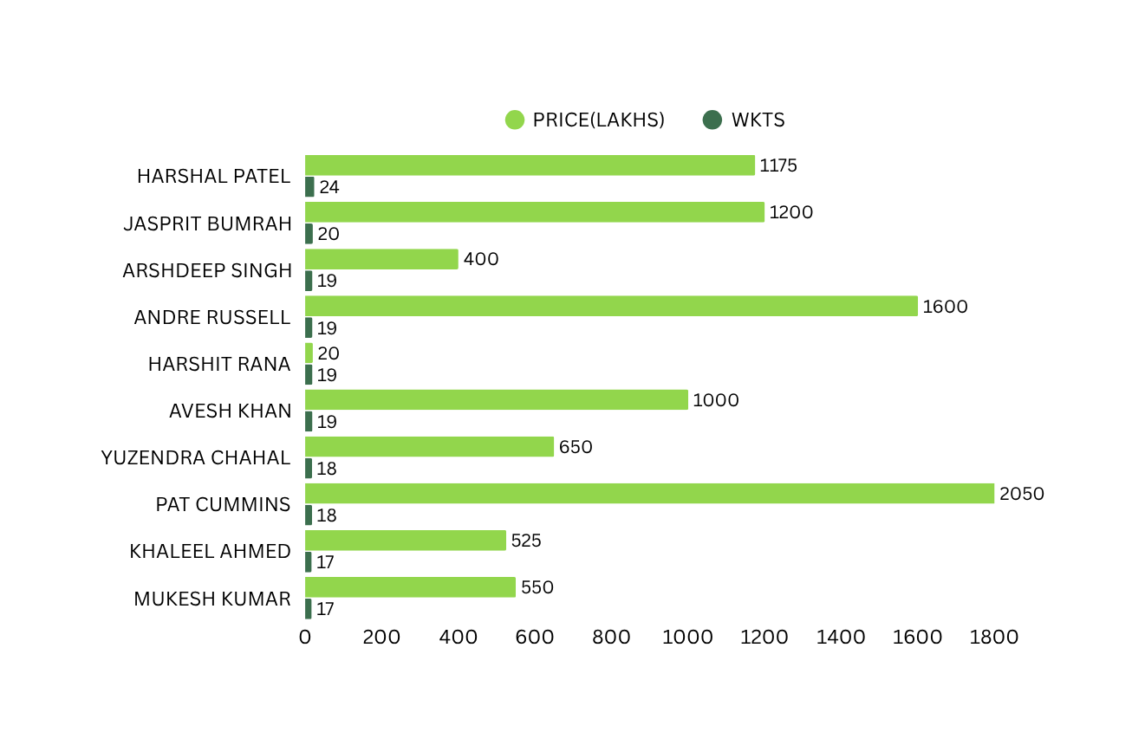
PRICE VS PERFORMANCE OF TOP 10 BOWLERS

Slide 9
BHHBBHHHJ
FINDINGS
Mitchell Starc & Pat Cummins fetched record bids, highlighting demand for elite pacers.
Virat Kohli & Sanju Samson topped 500+ runs ; high strike rates were key.
Harshal Patel & Jasprit Bumrah led with 20+ wickets and strong economy.
Teams prioritized fast bowlers & impactful all-rounders.
Uncapped players like Harshit Rana & Sai Sudharsan delivered big returns at low price.
Some expensive players like Rohit Sharma , Rishabh Pant, Mitchell Starc & Sam Curran didnot justify their prices.

Slide 10
INSIGHTS
1.Invest in reliable fast bowlers for match-winning impact.
2. Back proven top-order players like Virat Kohli & Harshal Patel .
3.Focus on aggressive players with strong strike rates who can accelerate scoring .
4.Identify low priced domestic players with potential.
5.Choose players based on their current form , not just frame.
6.All-rounders add depth & balance to the squad.

Slide 11


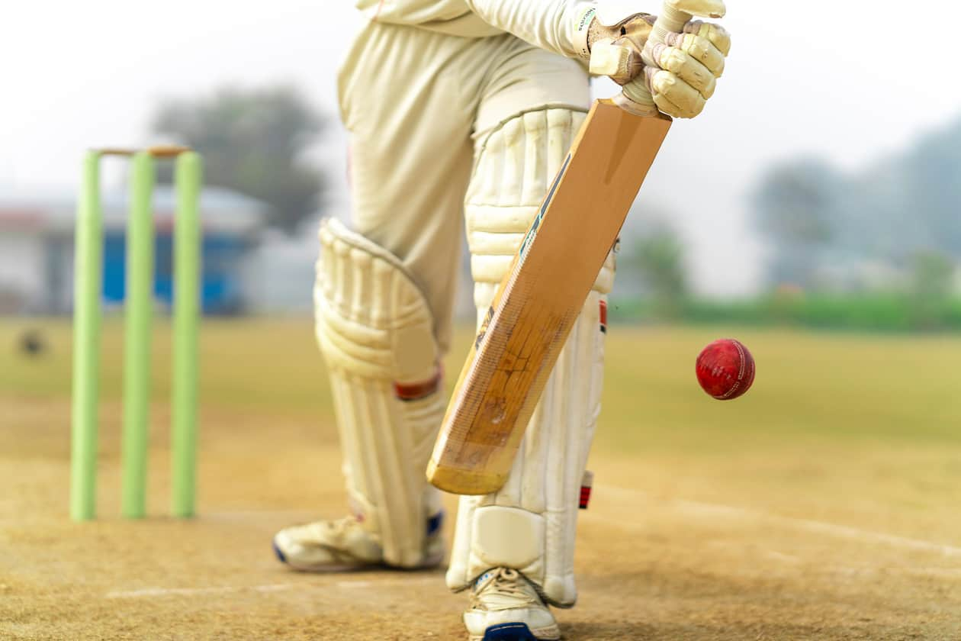
THANK YOU

